Slide 1

Aryan Purohit
Ankit Singh
Ajay Khavle

Slide 2
TOPICS
Introduction​
Technologies Used
Working
Advantages
Future Scope
​

Slide 3
Introduction
Student Dashboard is a web app developed to help students with their problems related to academics. In this web app students can find study material according to their streams, can arrange resources, set remainders for upcoming exams, submissions and orals. It also creates an ample environment for them to study.

Slide 4
Technologies used
HTML
CSS
JAVASCRIPT
CANVA(LOGO DESIGN)
BOOTSTRAP
GITHUB(DEPLOYMENT)

Slide 5
Working
Student Dashboard works using technologies like HTML,CSS and Javascript.HTML is used to give a basic structure to a website justifying position of logo, navigation bars and announcement board.CSS is used to give style, padding, margins and making the website responsive i.e. compatible for all available devices. JavaScript is a programming language, in this website its used to manipulate the website, for example when you click on timetable it takes you to timetable tab, it also keeps a track of the date and time to show the timetable for following day and it can also allow students to keep certificates in one page.

Slide 6
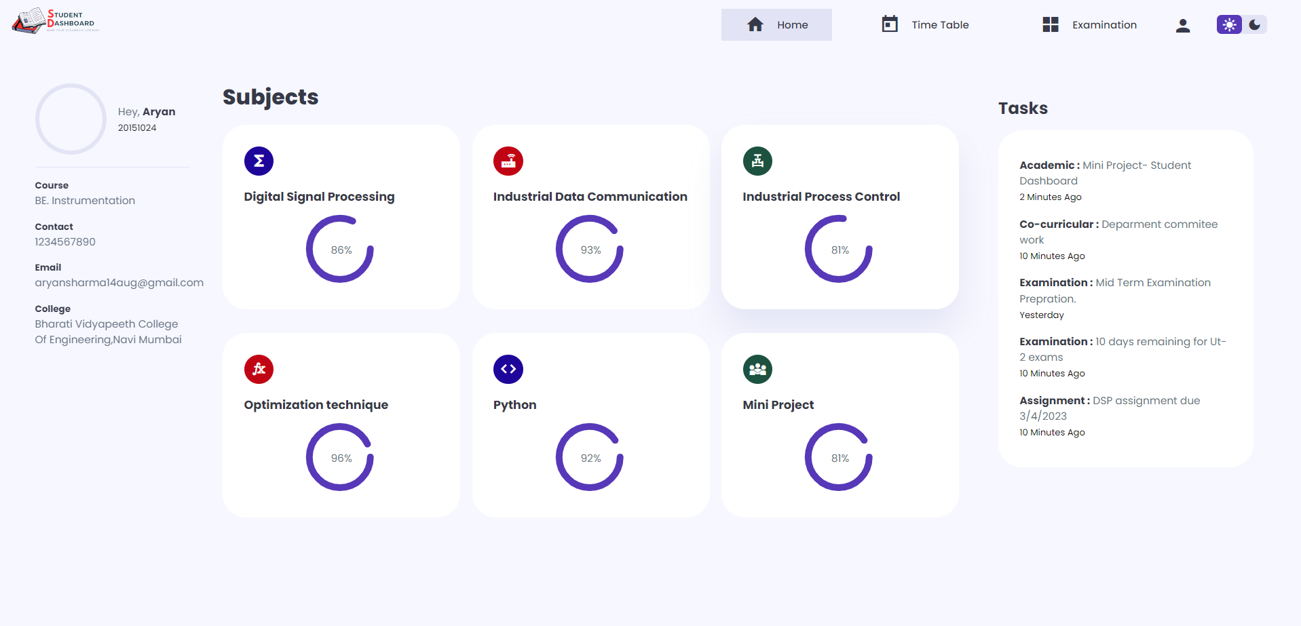
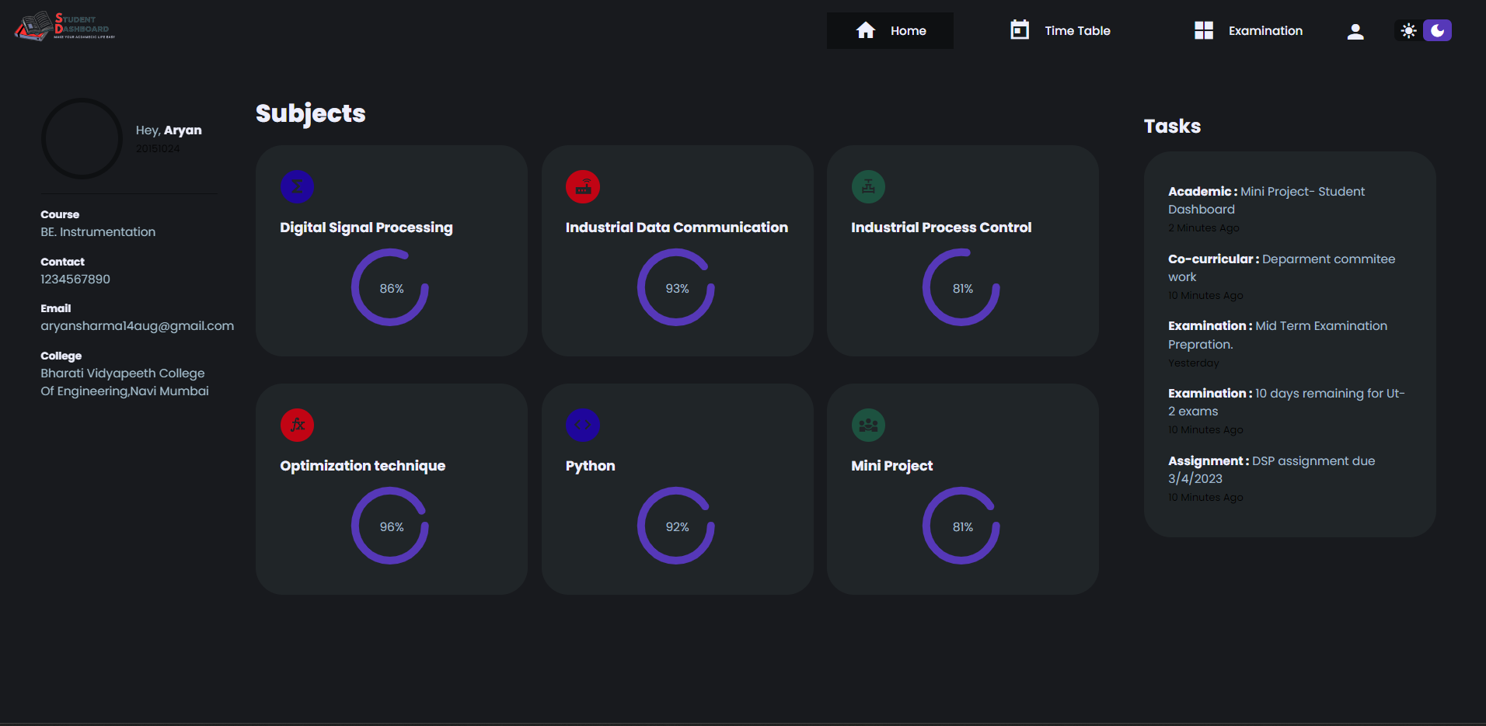
WEBSITE ON NORMAL MODE
WEBSITE ON DARK MODE (FOR COMFORTABLE VIEWING IN NIGHT)

Slide 7
ADVANTAGES
Allow students to get notes.
Create an environment for students to study
Set remainders for upcoming activities related to academics
Put all certificates and resources in one website.

Slide 8
Future Scope
Creating a backend framework so students can login in it.
Using same backend to upload notes
Also allow students to visit outer links to access books on different website (ex.-Amazon, Flipkart).

Slide 9
THANK YOU

